Slide 1
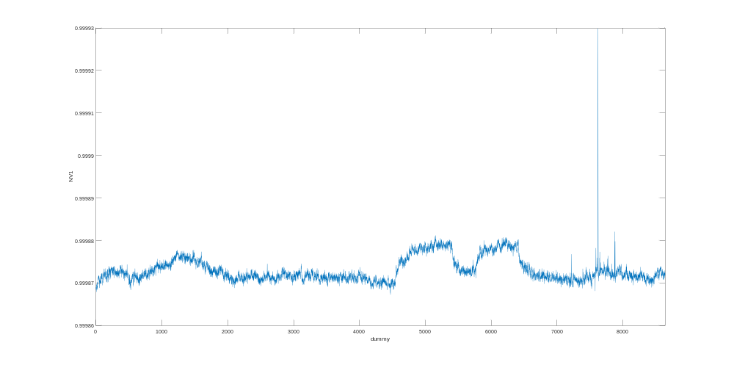
20220714_KEATHLEY2400_LongTerm_002.mat
7/15/2022 2:06 PM
K1 = 1
Start Time: 20220714 1407
End time: 20220715 1407
Range for Keathley 2400: 10V
Range for Keathley 2182: 1V
Slow Mode, Filter On
More Details:
-Right side of the Electronics Bench
-Along with the Yokogawa GS200 at the top
-Around 10 people in lab

